Slide 1
Automatic temperature tester
BY:
PRAVEEN.D
ROBOTICS AND AUTOMATION ENGINEERING
1st year
MANAKULA VINAYAGAR INSTITUTE OF TECHNOLOGY

Slide 2
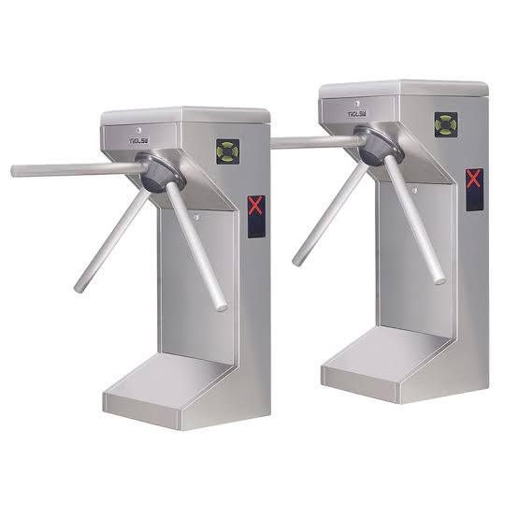
model
Automatic temperature tester without a person.
It is a model of a entrance gate in a office or a company.
In this entrance gate a id card or rfid chip is used to enter .
In this entrance gate I have implemented MCP infrared thermometer instead of scanner.

Slide 3
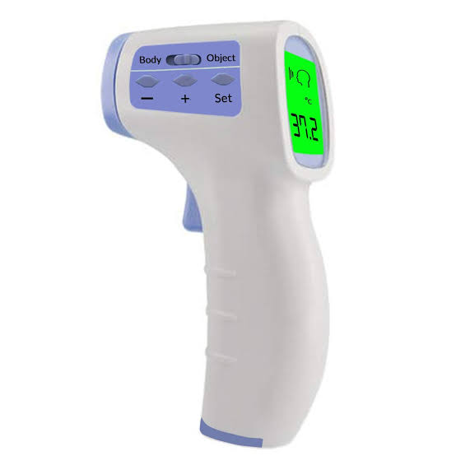
In this thermometer instead of switch I have installed ultrasonic sensor or ir sensor.
It will be automatically off when there is no one in front of the gate .
I have used pir sensor for detecting peoples on the sensor and the gate . So we can save the usage of the current.

Slide 4

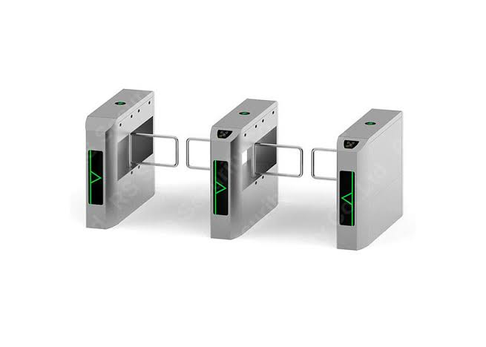
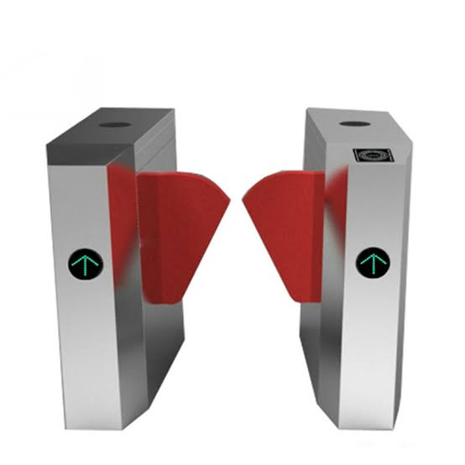
We can also use the gate like this to manage money conception
The gate Can be made by us.

Slide 5
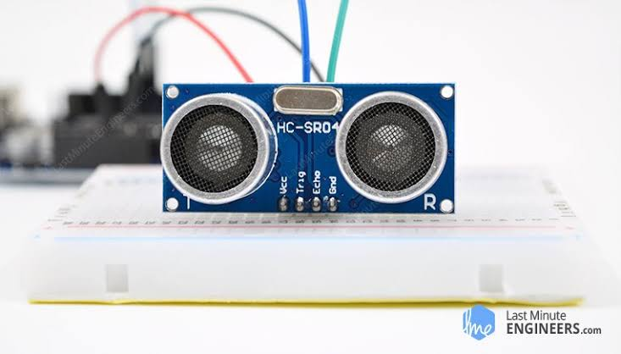
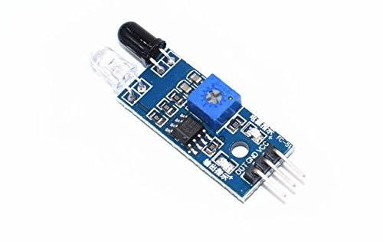
Ultrasonic sensor or ir sensor and pir sensor is connected with the arduino .
And the thermometer is connected with the arduino
The relay is connected with the arduino is used for connect the gate .

Slide 6
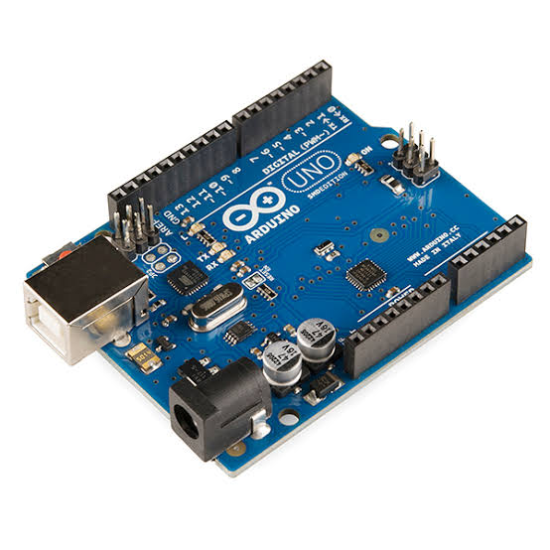
When we set the minimum temperature in the arduino . so if the temperature of a person is in the limit the person to enter the office or an institution.

Slide 7
Thank you by: PRAVEEN.D

